Slide 1
Presented By S.ITHAYA EZHIL MANNA Assistant Professor In Mathematics St.Joseph’s College Trichy-2.
RELIABILITY THEORY

Slide 2
Let the random variable X be the life time or the time to failure of the component.
The reliability of the component is deﬁned by R(t) = P(X> t).

Slide 3
Let the random variable X be the life time or the time to failure of the component.
The reliability of the component is deﬁned by R(t) = P(X> t).
Remarks:
1. The component is assumed to be working properly at time t = 0 (i.e) R(0) = 1.

Slide 4
Let the random variable X be the life time or the time to failure of the component.
The reliability of the component is deﬁned by R(t) = P(X> t).
Remarks:
1.The component is assumed to be working properly at time t = 0 (i.e)R(0) = 1.
2.No component can work forever without failure limn→∞ R(t) = 0.

Slide 5
Let the random variable X be the life time or the time to failure of the component.
The reliability of the component is deﬁned by R(t) = P(X> t).
Remarks:
1.The component is assumed to be working properly at time t = 0 (i.e)R(0) = 1.
2.No component can work forever without failure limn→∞ R(t) = 0
3.R(t) is a monotone non-increasing function of t.

Slide 6
Let the random variable X be the life time or the time to failure of the component.
The reliability of the component is deﬁned by R(t) = P(X> t).
Remarks:
1.The component is assumed to be working properly at time t = 0 (i.e)R(0) = 1.
2.No component can work forever without failure limn→∞ R(t) = 0
3.R(t) is a monotone non-increasing function of t.
4. For t < 0, reliability has no meaning, but we let R(t) = 0, for t < 0.

Slide 7
failure rate or hazard rate:
The failure rate ‘ h(t) ’ at time t is deﬁned to be

Slide 8
failure rate or hazard rate:
The failure rate ‘ h(t) ’ at time t is deﬁned to be

Slide 9
failure rate or hazard rate:
The failure rate ‘ h(t) ’ at time t is deﬁned to be
Cumulative Failure Rate:

Slide 10
failure rate or hazard rate:
The failure rate ‘ h(t) ’ at time t is deﬁned to be
Cumulative Failure Rate:

Slide 11
Parameters of Reliability
1.MTTF: Mean Time To Failure

Slide 12
Parameters of Reliability
1.MTTF: Mean Time To Failure
2. MTBF: Mean Time Between Failures

Slide 13
Parameters of Reliability
1.MTTF: Mean Time To Failure
2. MTBF: Mean Time Between Failures
3. MTTR: Mean Time To Repair

Slide 14
exponential distribution

Slide 15
exponential distribution
Suppose the random variable X (be the lifetime of a component) is said to follow the exponential distribution,then

Slide 16
exponential distribution
Suppose the random variable X (be the lifetime of a component) is said to follow the exponential distribution,then

Slide 17
exponential distribution
Suppose the random variable X (be the lifetime of a component) is said to follow the exponential distribution,then
Hence,the exponential lifetime distribution is a constant failure rate [ It’s the only distribution with a constant failure rate].

Slide 18
Weibull Distribution:
The density function is given by,

Slide 19
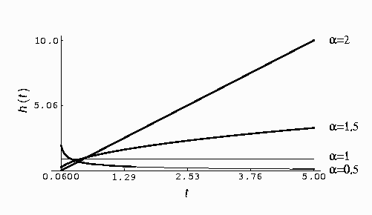
Failure rate of the weibull distribution with various values of α and λ = 1
1 . If α <1,the function is DFR.
2. If α = 1,the function is CFR.
3. If α >1,the function is IFR.

Slide 20
APPLICATIONS
1. Reliability engineering - Reliability engineering is engineering that emphasizes dependability in the lifecycle management of a product. Dependability, or reliability, describes the ability of a system or component to function under stated conditions for a specified period of time.
2. System Reliability - The probability that a system, including all hardware, firmware, and software, will satisfactorily perform the task for which it was designed or intended, for a specified time and in a specified environment.
3. Structural reliability.

Slide 21
REFERENCES:
1 . J.Medhi,Stochastic Processes,New Age International Publishers,Second Edition,New Delhi,1994.
2 . U.Narayan Bhat,Elements of Applied stochastic Processes,second Edition,John Wiley & Sons,New York,1972.
3 . N.V.Prabhu,stochastic processes,Macmillan,NewYork,1970.

Slide 22
THANK YOU

